Slide 1
Dossier Architecture Général
PRO1 - TMS

Slide 2
Informations
Code: PRO1
Titre: TMS
Type: TPRO1 - Implementation
Statut: En cours
Sponsor: ENT1 - VT Supply Chain (Interne)
Réference du train:
Méteo:
Taux avancement global estimé: 0%
Taux avancement délai: 0%

Slide 3
Informations
Date de début: 2025-06-01
Date de fin estimée: 2026-09-30
Date de fin réelle:
Budget OPEX estimé:
Budget OPEX réel:
Budget CAPEX estimé:
Budget CAPEX réel:

Slide 4
Contexte
OPmobility has decided to implement a central TMS (Transport Management System) solution that did not previously exist (either at the local or central level). This solution requires process changes in the supply chain, the creation of ad-hoc department, and the implementation of an IT system supporting the entire process. This solution will transform the transport operations’ company across Mexico, US/Canada, Europe, and the rest of the world (APAC and , South America regions).

Slide 5
Démarche

Slide 6
Exigences
Exigence | Type | Description
PROEX1 | Non fonctionnelle | User characteristics:_x000D_ In general, the users will be able to use the solution from a PC, a laptop or a tablet via the web portal of the solution. External partners will access the application only via the web portal; the admin user will have direct access (such as SSH) to the solution.
PROEX2 | Non fonctionnelle | Location characteristics:_x000D_ The solution will be in long term to spread worldwide. In the context of the current document, the following country/region will be in the order withing the scope: Mexico, US/Canada, EMEA, APAC, SAO
PROEX3 | Non fonctionnelle | Load characteristics:_x000D_ The shipment volume will progressively increase yearly: 2026: 100 000 shipments,2027: 450 000 shipments,2028: 470 000 shipments_x000D_ These volumes are approximative and will be detailed during the editor workshops.

Slide 7
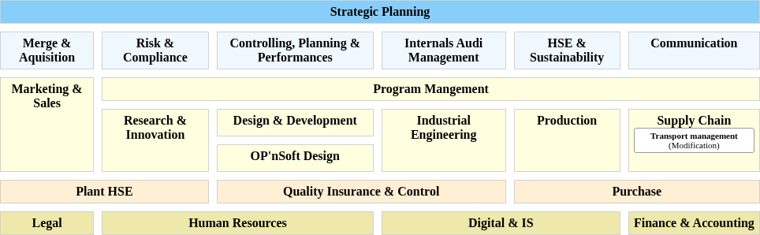
POS des capacités impactées

Slide 8
Capacités impactées
Capacité | Type | Impact
CAP156 - Transport management | Modification | None

Slide 9
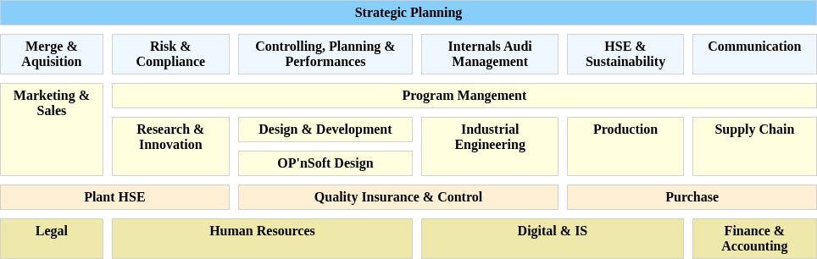
POS des objet métiers impactés

Slide 10
Objet métiers impactés
Objet métier | Type | Impact
OM8 - Carrier invoice | Modification | None
OM6 - Customers | Modification | None
OM4 - Materials | Modification | None
OM11 - Outbound ASN | Modification | None
OM7 - Packaging instr | Modification | None

Slide 11
Objet métiers impactés
Objet métier | Type | Impact
OM10 - Supplier firm demand | Modification | None
OM9 - Supplier forecast | Modification | None
OM5 - Suppliers | Modification | None

Slide 12
Solution applicative: PROSCEN1 - Applicative Solution

Slide 13
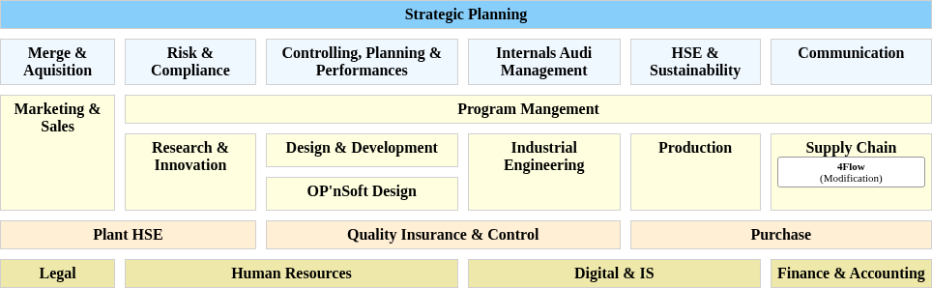
POS des applications impactées

Slide 14
Application impactées
Application | Type | Impact
APP954 - 4Flow | Modification | Introduction of a central TMS for transport planning, execution, optimization, and freight invoice control. Consumes master and demand data from SAP/EDI, performs transport and MRP related optimization, and sends outputs back to SAP. Carrier operational systems remain out of OPMobility responsibility.
APP955 - BOOMI | Modification | Extension of the integration layer to orchestrate SAP–TMS exchanges. Implements new SAP interfaces (master data, invoices) using the Boomi for SAP add on where available, or custom BAPIs for Lighting.
APP952 - SAP ECC6 Exterior | Modification | Activation and extension of interfaces toward the TMS ecosystem: exposure of master data, exchange of MRP optimization results, reception of carrier invoices for posting and archiving, and generation of new outbound logistics messages (plant to plant and returnable ASN)

Slide 15
Flux logiques impactés
Flux logique | Type | Impact
FLOG9 - Carrier Invoice (4Flow -> BOOMI) | Modification | None
FLOG10 - Carrier invoice (BOOMI -> SAP ECC6 Exterior) | Modification | None
FLOG18 - Empty Packaging ASN (EDI Exterior -> 4Flow) | Modification | None
FLOG17 - Empty Packaging ASN (SAP ECC6 Exterior -> EDI Exterior) | Modification | None
FLOG3 - MD Customers (SAP ECC6 Exterior -> BOOMI) | Modification | None

Slide 16
Flux logiques impactés
Flux logique | Type | Impact
FLOG5 - MD Customers (BOOMI -> 4Flow) | Modification | None
FLOG1 - MD Materials (SAP ECC6 Exterior -> BOOMI) | Modification | None
FLOG6 - MD Materials (BOOMI -> 4Flow) | Modification | None
FLOG4 - MD Packaging instr (SAP ECC6 Exterior -> BOOMI) | Modification | None
FLOG8 - MD Packaging instr (BOOMI -> 4Flow) | Modification | None

Slide 17
Flux logiques impactés
Flux logique | Type | Impact
FLOG2 - MD Suppliers (SAP ECC6 Exterior -> BOOMI) | Modification | None
FLOG7 - MS Suppliers (BOOMI -> 4Flow) | Modification | None
FLOG16 - Plant to Plant ASN (EDI Exterior -> 4Flow) | Modification | None
FLOG15 - Plant to Plant ASN (SAP ECC6 Exterior -> EDI Exterior) | Modification | None
FLOG14 - Supplier Firm Demand (EDI Exterior -> 4Flow) | Modification | None

Slide 18
Flux logiques impactés
Flux logique | Type | Impact
FLOG13 - Supplier Firm Demand (SAP ECC6 Exterior -> EDI Exterior) | Modification | None
FLOG12 - Supplier Forecast (EDI Exterior -> 4Flow) | Modification | None
FLOG11 - Supplier Forecast (SAP ECC6 Exterior -> EDI Exterior) | Modification | None

