Slide 1
Dossier Architecture Général

Slide 2
Informations
Code: PRO1
Titre: TMS
Type: TPRO1 - Implementation
Statut: En cours
Sponsor: ENT1 - VT Supply Chain (Interne)
Réference du train: None
Méteo: None
Taux avancement global estimé: 0
Taux avancement délai: 0

Slide 3
Informations (suite)
Date de début: 2025-06-01 00:00:00
Date de fin estimée: 2026-09-30 00:00:00
Date de fin réelle: None
Budget OPEX estimé: None
Budget OPEX réel: None
Budget CAPEX estimé: None
Budget CAPEX réel: None

Slide 4
Contributeurs
Entité | Acteur | Rôle
ENT1 - VT Supply Chain (Interne) | Courseaux David | Architecte domain

Slide 5
Contexte
OPmobility has decided to implement a central TMS (Transport Management System) solution that did not previously exist (either at the local or central level). This solution requires process changes in the supply chain, the creation of ad-hoc department, and the implementation of an IT system supporting the entire process. This solution will transform the transport operations’ company across Mexico, US/Canada, Europe, and the rest of the world (APAC and , South America regions).

Slide 6
ADR
ADR | Description
ADR1 - ADR

Slide 7
Key results
Key result | Description | Type
ECART1 - Key result | This is a key result | Fonctionnel

Slide 8
Processus
Processus
PROCESS1 - Processus

Slide 9
Processus: PROCESS1 - Processus

Slide 10
Adhérences
Projet | Type | Impact
PRO1 - TMS | Projet interne | Impact on itself ;-)
External project - An external project | Projet externe | Has impact on TMS project

Slide 11
Démarche

Slide 12
Contraintes
Contrainte | Description
PROCONT1 - Constraint | A constraint

Slide 13
Exigences
Exigence | Type | Description
PROEX1 | Non fonctionnelle | User characteristics: Users can access the solution via a web portal from a PC, laptop, or tablet. External partners use only the web portal, while admin users have direct access (e.g., SSH).
PROEX2 | Non fonctionnelle | Location characteristics: The solution is intended for global deployment, with initial rollout in the following order: Mexico, US/Canada, EMEA, APAC, and SAO.
PROEX3 | Non fonctionnelle | Load characteristics: Shipment volume will increase over time (approx.): 100,000 in 2026, 450,000 in 2027, and 470,000 in 2028. Final figures will be refined during workshops.

Slide 14
Sécurite
Sécurité | Description
PROSECU1 - Security recommandation | A security recommandation

Slide 15
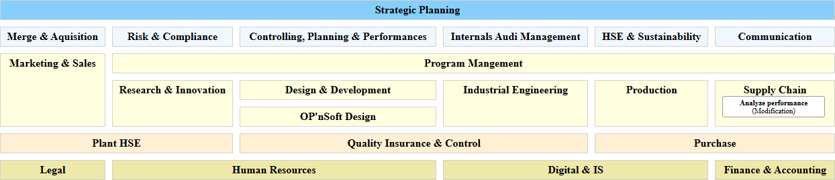
Plan d'occupation des sols impacté

Slide 16
Capacités
Capacité | Type | Impact
CAP156 - Analyze performance | Modification | None

Slide 17
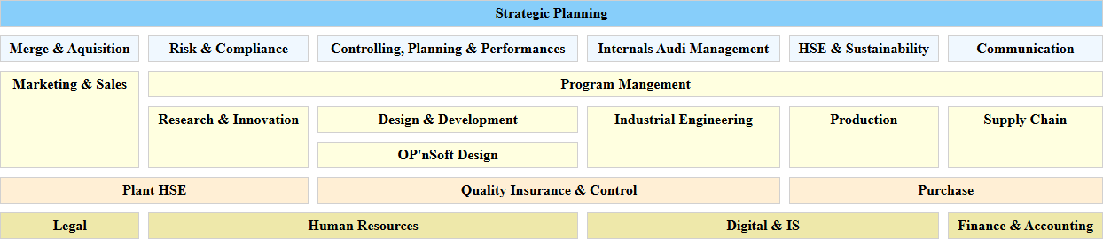
Cartographie des données impactée

Slide 18
Objets métiers
Objet métier | Type | Impact
OM6 - Customers | Modification | None

Slide 19
Services
Service | Type | Impact
SERV1 - Service | Modification | None

Slide 20
Solution applicative: PROSCEN1 - Applicative Solution
None

Slide 21

Paysage applicatif impacté

Slide 22
Applications
Application | Type | Impact
APP954 - 4Flow | Modification | Introduction of a central TMS for transport planning, execution, optimization, and freight invoice control. Consumes master and demand data from SAP/EDI, performs transport and MRP related optimization, and sends outputs back to SAP. Carrier operational systems remain out of OPMobility responsibility.
APP955 - BOOMI | Modification | Extension of the integration layer to orchestrate SAP–TMS exchanges. Implements new SAP interfaces (master data, invoices) using the Boomi for SAP add on where available, or custom BAPIs for Lighting.
APP952 - SAP ECC6 Exterior | Modification | Activation and expansion of interfaces with the TMS ecosystem: master data exposure, exchange of MRP optimization results, integration of carrier invoices (posting and archiving), and generation of outbound logistics messages (plant-to-plant and returnable ASN).

Slide 23
Composants logiciels
Composant logiciel | Type | Impact
CLOG321 - BOOMI (BOOMI) | Modification | impact composant logiciel

Slide 24
Flux logiques
Flux logique | Type | Impact
FLOG10 - Carrier invoice (BOOMI -> SAP ECC6 Exterior) | Modification | impact flux logique

